Slide 2
FIT 152 Fundamentals of Information Technology
Lecture 9
Topic 4: Development and deployment of IT systems

Slide 3
FIT 152: Module outcomes
Upon successful completion of this course, the student will be able to:
Demonstrate an understanding of the relationship between IT and related and informing disciplines.
Demonstrate insight in the history of computing technology, and an understanding of the Internet, and the World-Wide Web, as well as the components of an IT system and how they interrelate.
Demonstrate an understanding of complexity in an information technology environment and how and why it occurs.
Demonstrate an understanding of why life-long learning and continued professional development is critical for an IT professional.
Illustrate the use of information and communication technologies to solve problems.
Demonstrate an understanding of how and to what extent IT has changed various application domains.

Slide 4
The role of the IT Professional
Read Cadle, Chapter 3
Definition of an IT Professional
An IT professional is an expert who utilizes technology to solve business problems, enhance efficiency, and drive innovation across various industries.
At its core, the role of an IT professional is to leverage technology to solve problems, improve processes, and drive innovation.
IT professionals are responsible for designing, developing, implementing, and maintaining various technology systems, networks, and applications.
They work across different industries, including healthcare, finance, education, entertainment, and government, among others.
Essential skills of an IT Professional
Problem solving
Technical expertise
Communication skills
Adaptability
Attention to detail
Notes:
Essential Skills:
Technical Proficiency: A strong foundation in programming languages, operating systems, networking, and database management is essential.
Problem-Solving Abilities: IT professionals must possess excellent problem-solving skills to identify issues, analyze root causes, and develop effective solutions.
Communication Skills: Effective communication is vital for conveying technical information to non-technical stakeholders and collaborating with team members.
Adaptability: The IT landscape is constantly evolving, so IT professionals must be adaptable and willing to learn new technologies and methodologies.
Attention to Detail: In a field where small errors can have significant consequences, attention to detail is crucial for ensuring accuracy and reliability.

Slide 5
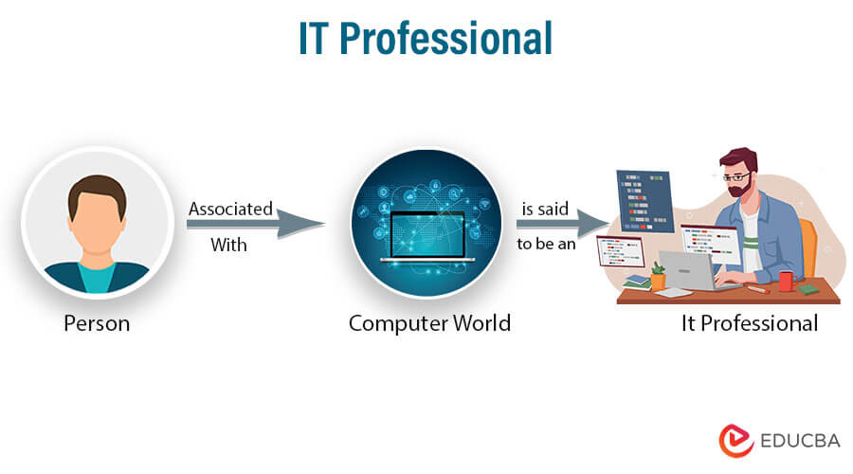
The role of the IT Professional
Read Cadle, Chapter 3
Key Responsibilities:
System Administration: Managing and maintaining computer systems, servers, networks, and databases to ensure they operate efficiently and securely.
Software Development: Creating, testing, and deploying software applications to meet specific business needs or user requirements.
Cybersecurity: Protecting sensitive data and systems from cyber threats, such as hackers, malware, and viruses.
Data Analysis: Collecting, analyzing, and interpreting data to help organizations make informed decisions and gain competitive advantages.
Technical Support: Assisting users with troubleshooting issues and providing technical assistance to ensure smooth operation of technology systems.

Slide 6
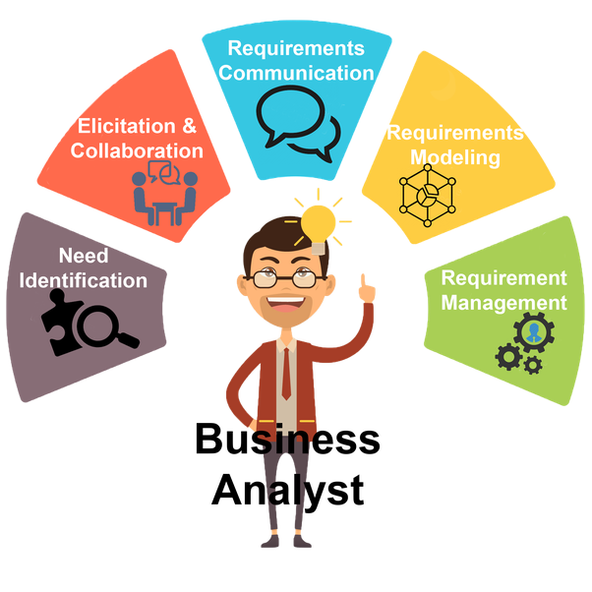
Business Analyst
Read Cadle, Chapter 3
Business analysts use data to form business insights and recommend changes in businesses and other organizations. Business analysts can identify issues in virtually any part of an organization, including IT processes, organizational structures, or staff development.
A business analyst is a person who processes, interprets and documents business processes, products, services and software through analysis of data. The role of a business analyst is to ensure business efficiency increases through their knowledge of both IT and business function.

Slide 7
Business Analyst skills
Read Cadle, Chapter 3
Data Analysis
Proficiency in data analysis tools and techniques, such as SQL (Structured Query Language), Excel, data visualization tools (e.g., Tableau, Power BI), and statistical analysis software (e.g., R, Python). These skills help business analysts extract insights from large datasets and make data-driven recommendations.
Business Intelligence tools
Familiarity with BI tools like SAP BusinessObjects, IBM Cognos, or Microsoft Power BI. These tools enable business analysts to create reports, dashboards, and interactive visualizations to provide valuable insights to stakeholders.
Process modelling and analysis
Knowledge of process modeling techniques, such as BPMN (Business Process Model and Notation), and process analysis tools like ARIS or Visio. Business analysts use these skills to map and analyze business processes, identify inefficiencies, and propose improvements.
Requirements management
Proficiency in requirements management tools like JIRA, Confluence, or IBM Rational DOORS. These tools help business analysts capture, document, track, and manage requirements throughout the project lifecycle.

Slide 8
Business Analyst skills (cont)
Read Cadle, Chapter 3
Agile methodologies
Understanding of Agile methodologies like Scrum or Kanban, and familiarity with Agile project management tools like JIRA or Trello. Business analysts with Agile skills can effectively collaborate with development teams, facilitate sprint planning, and participate in Agile ceremonies.
Systems Analysis
Knowledge of system analysis techniques, such as UML (Unified Modeling Language), to effectively analyse and document system requirements, use cases, and workflows.
Prototyping and wireframing
Proficiency in tools like Axure RP, Balsamiq, or Sketch to create interactive prototypes, wireframes, and mock-ups. These skills enable business analysts to visually communicate requirements and validate solutions with stakeholders.
Knowledge of ERP and CRM systems
Familiarity with enterprise resource planning (ERP) systems like SAP or Oracle, and customer relationship management (CRM) systems like Salesforce. Understanding these systems helps business analysts gather requirements, evaluate integration needs, and support implementation projects.

Slide 9
Business Analyst skills (cont)
Read Cadle, Chapter 3
Software Development lifecycle
Familiarity with the various phases of the SDLC is important for business analysts to work effectively with development teams and ensure smooth project execution.
Programming languages
Business analysts should have hands-on programming knowledge in order to perform quicker and better data analysis. Knowledge of R and Python is extremely beneficial. Complex problems can be solved by writing efficient codes. R and Python comprise several libraries and packages for data wrangling, data manipulation, data visualization, and analytics. Additionally, a sound understanding of statistical software like SAS and SPSS is recommended. With the help of the above programming languages, massive data can be analyzed and visualized finely. Also, business models can be created for making business predictions.
Creation of reports and dashboards
The next vital skill we have is the creation of reports and dashboards. Business analysts must be proficient in using various business intelligence tools for creating reports and dashboards. Business analysts develop general reports and dashboard reports to solve decision-making problems. Sound knowledge of Tableau, QlikView, and Power BI is necessary to make different reports based on the business requirements.
Database and SQL
Business analysts most often work with structured data. In order to store and process this heavy data, they should have a sound understanding of relational databases like Microsoft SQL Server, MySQL database, Oracle DB, as well as NoSQL databases.

Slide 10
QUIZ
Question 1: What is the role of a data analyst?
A) Develop software
B) Manage IT infrastructure
C) Gather and analyse information
D) Write code
Question 2: What type of diagrams are commonly used by business analysts to visualize processes and workflows?
A) Pie charts
B) UML diagram
C) Microsoft Word
D) PowerPoint

Slide 11
QUIZ - ANSWERS
Question 1: What is the role of a data analyst?
A) Develop software
B) Manage IT infrastructure
C) Gather and analyse information
D) Write code
Question 2: What type of diagrams are commonly used by business analysts to visualize processes and workflows?
A) Pie charts
B) UML diagram
C) Microsoft Word
D) PowerPoint

Slide 12
QUIZ
Question 3: Which of the following is NOT a key skill for a business analyst?
A) Requirement Gathering B) Data Visualization C) Programming in Python D) Stakeholder Communication
Question 4:
Question 4: Which of the following activities is a typical responsibility of a data analyst?
A) Developing machine learning models B) Conducting user experience research C) Cleaning and transforming data D) Writing software code for applications

Slide 13
QUIZ - ANSWERS
Question 3: Which of the following is NOT a key skill for a business analyst?
A) Requirement Gathering B) Data Visualization C) Programming in Python D) Stakeholder Communication
Question 4: Which of the following activities is a typical responsibility of a data analyst?
A) Developing machine learning models B) Conducting user experience research C) Cleaning and transforming data D) Writing software code for applications

